Slide 1
LIBRARY MANAGEMENT
NIKHIL LODHA
SUBMITTED TO:- Prof. D.V. Dhawase

Slide 2
Introduction
The purpose of a library management system is to operate a library with efficiency and at reduced costs. The system being entirely automated streamlines all the tasks involved in operations of the library. The activities of book purchasing, cataloging, indexing, circulation recording and stock checking are done by the software. Such software eliminates the need for repetitive manual work and minimizes the chances of errors.
The library management system software makes the library a smart one by organizing the books systematically by author, title and subject. This enables users to search for books quickly and effortlessly.

Slide 3

PROJECT DOMAIN:- WEB DEVELOPMENT
TITLE:-
LIBRARY MANAGEMENT SYSTEM

Slide 4

PROBLEM STATEMENT
More Accuracy
Both teacher and student can issue books
Book wise search can be performed

Slide 5
ABSTRACT
The library management system software makes the library a smart one by organizing the books systematically by author, title and subject. This enables users to search for books quickly and effortlessly.
The system saves time for both the user and the librarian. With just a click the user can search for the books available in the library. The librarian can answer queries with ease regarding the availability of books. Adding, removing or editing the database is a simple process. Adding new members or cancelling existing memberships can be done with ease.
Stock checking and verification of books in the library can be done within a few hours. The automated system saves a considerable amount of time as opposed to the manual system.
Students need access to authentic information. An advanced organized library is an integral part of any educational institution. In this digital age a web based library management system would be ideal for students who can access the library’s database on their smartphones.

Slide 6
OBJECTIVES
More Accuracy
Speed Improvement
Book wise search can be performed
System will handle the maintenance of all data
Better error handling

Slide 7
REQUIREMENTS
SOFTWARE REQ.
Languages like HTML, CSS, BOOTSTRAP, JS, PHP,
SQL server
Database
HARDWARE REQ.
Operating system: Windows
RAM: 4GB
Processor: i3 7Gen
FUNCTIONAL REQ.
Book Entry
Register student
Book Issue
Book Return

Slide 8
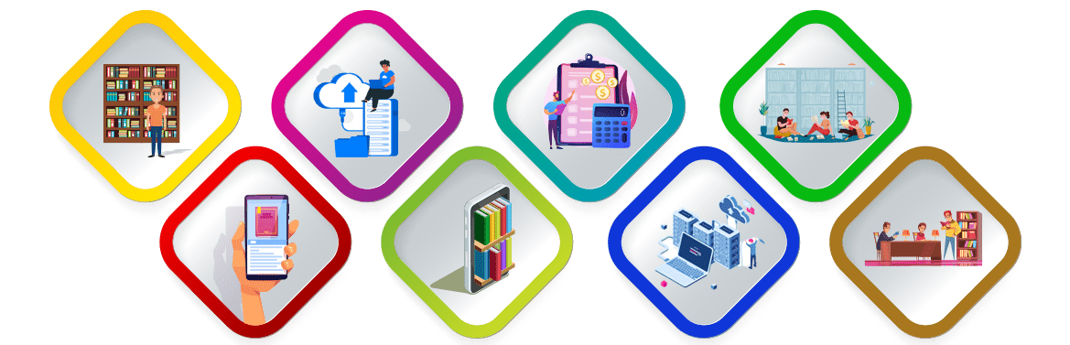
THE MAIN CLASSES OF LIBRARY MANAGE

Slide 9
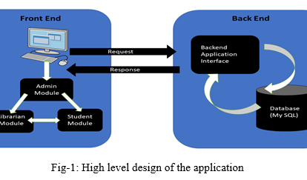
ARCHITECTURE
As we know, any software application consists of broadly three parts: Front-End, Back-End and a Database part. This application also has these three parts.
The front-end part helps the admin and librarian to interact with the database.
These modules can be accessed by the administrator, librarian and students by interacting with the front-end screens of the application respectively. The modules are internally connected with the backend portion and the database.

Slide 10
ADVANTAGES OF LIBRARY MANAGEMENT SYSTEM SOFTWARE
User friendly system
Simplification of librarian duties
Increased member engagement
Efficient data management
Time and effort saver​
Automated reports​
Cost effective

Slide 11
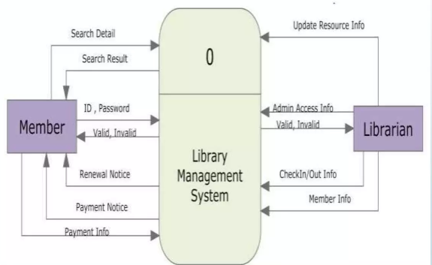
STATE DIAGRAM

Slide 12
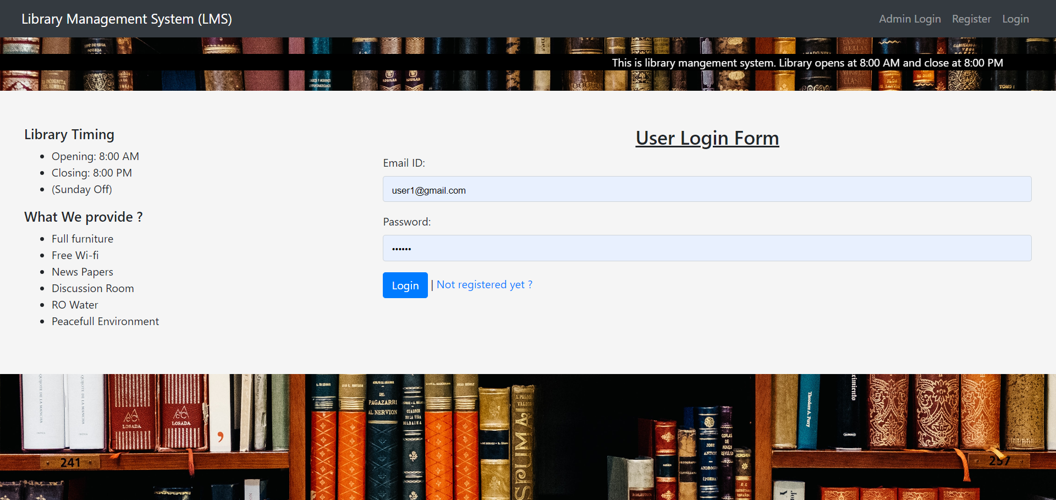
E-LIBRARY MANAGEMENT SYSTEM

Slide 13
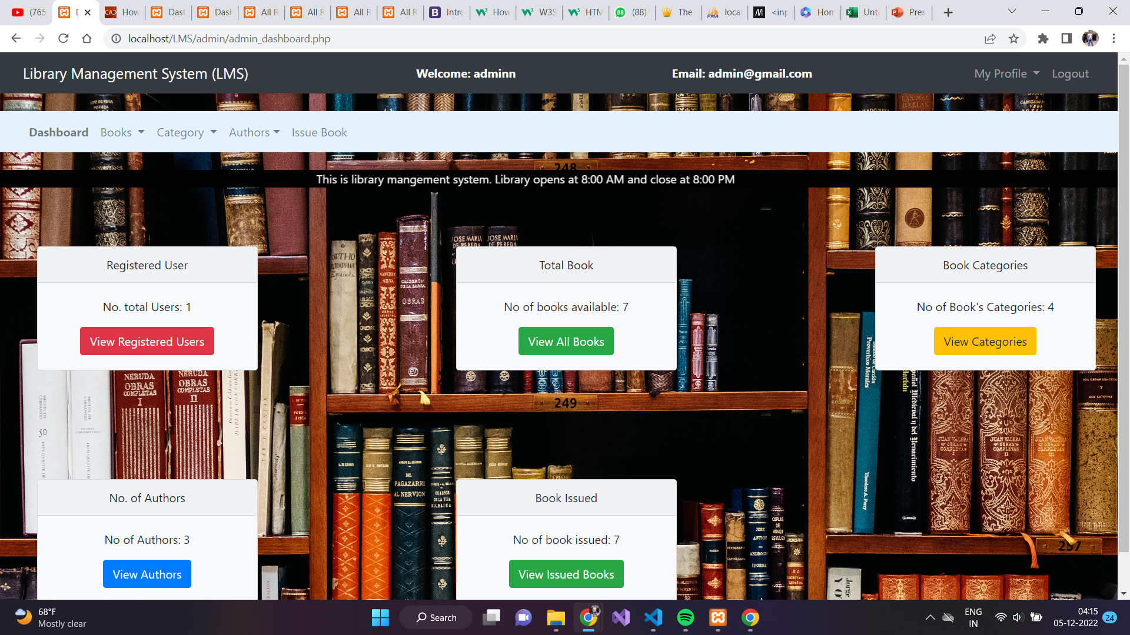

Slide 14
LITERATURE SURVEY
Sr. No. | PAPER NAME | AUTHOR NAME | YEAR | ALGORITHM / TECHNIQUES / METHODS | RESULTS / ACCURACY | ADVANTAGES | DISADVANTAGES
1 | ONLINE LIBRARY MANAGEMENT SYSTEM | NAMBURI SAI NAGA LAKSHMI PRASANNA, B.N.SRINIVASA GUPTA | 2020 |  |  | The proposed system is automated that is faster book, search for a book, renew a book, return a book and can send mails to the admin regarding any issue related to the books. | Maintaining the data in excel sheets and files is very hard to remember the file names in which the required data is feed. No easy access to the required queries. Data redundancy, inconsistency, lot of human work need to be done in order analyze the details present in the excel sheets.
2 | Library Management System | Shanmugam A.P, Ramalakshmi, Sasthri, Baalachandran | 2020 |  |  | In the Library Management system, the librarian can add/update/remove the student and book details into the database. The students have a Unique ID for accessing any book from the library | They mainly concentrate on library lending for designing the construction of the model library.
3 | Designing Web-based Library Management System | Tsega Weldu Araya, Ass. Pro. Adhana Mengsteab | 2020 |  |  | The advantage of using proper management in the information system and the sustainability of library systems. . | A database creates to store different kinds of files to the system. Although the database is designed to edit, delete, and to add documents at any interval of time

Slide 15
4 | Global Research in Library Management from 2010 to 2020: A Bibliometric Investigation based on Scopus | Ankit Biswas, Dhruba Jyoti Borgohain | 2021 |  |  | it provides many opportunities and venues to manage the library and information services sustainably. | Libraries are basically paternalistic, service-oriented and not-for-profit organisations.
5 | Implementing BRICKS, a Digital Library Management System | Nicola Aloia, Cesare Concordia, Carlo Meghini | 2017 | source selection algorithm |  | . Typical digital library tools, are the core applications that can have benefit in using BRICKS, especially those dealing with multimedia documents. | the query optimizer to limit the data transfer
6 | The Centrality of the Integrated Library Management System: a Strategic View of Information Management in an E-Service Environment | Laura Maquignaz, Jane Miller | 2015 | Divide and conquer | 92% | New technologies and developments have altered the perceived link between information and libraries. For students of previous generations the library stood clearly as the first place to “begin” research and offered a number of options within its physical locations including “librarian, journal indexes or perhaps the more modern CD ROM” | this change in access to information and technology are the fundamental changes that have occurred in views of education and its role in society. Lifelong learning is the major educational movement discussed in relation to learners of this generation. Education as a continuing process throughout life in order to “maintain employment” coupled with the quest for “self improvement” and enhanced ability to solve
7 | A Security Mechanism for library management system using low cost RFID tags | Derek Hall , & Timothy SandsV.NagaLakshmi , I.Rameshbabu , D.Lalitha Bhaskari | 2020 | decryption algorithm. |  | RFID tags have several major advantages over optical barcode systems. Tag data may be read automatically, without line of sight, through non conducting materials such as paper or cardboard, at a rate of several hundred tags per second and from a range of several meters | problem readers have is reading a lot of chips in the same field. Tag clash occurs when more than one chip reflects back a signal at the same time, confusing the reader.

Slide 16
8 | Research on Human-Computer Interaction Intention Recognition Based on EEG and Eye Movement | MINRUI ZHAO 1 , HONGNI GAO1 , WEI WANG1 , AND JUE QU | 2020 | Intention Recognition | accuracy of 93.54%, and an average recognition accuracy of 89.22%, | the identification of multiple physiological information intentions.
9 | Context-aware Library Management System using Augmented Reality | Nishant Malhotra , Aayushi Singh , J. DivyaKrishna , Kanika Saini , Neeraj Gupta | 2018 | detection algorithm |  | The major benefit of mobile devices for AR is that the technology is ubiquitous and easily accessible to consumers. | the application itself stores the entire model of the library so it may not be scalable to larger, real-world libraries. Another limitation is that the system does not know the actual location of the book only the position where it is supposed to be located.
10 | e-commerce logistics distribution path planning based on Improved Genetic Algorithm | Lan Lan | 2022 | hybrid search algorithm | high accuracy, low error and good convergence | Optimize the analysis of e-commerce logistics distribution nodes, establish a modern logistics distribution system, and optimize the total transportation time and transportation cost under the location model of the logistics distribution center. | The main disadvantage of this distribution method is that gradually strengthened.

Slide 17
11 | An Introduction to a Library material management and security control system - Radio Frequency ldentification (RFID) technology | Thanuja C. Ranawella | 2016 | automatic identification method |  | RFlD has the added advantage that it can also provide security for the range of different media on offer in libraries. | The major drawbacks of RFlD technology is its cost. While the readers and gate sensors used to read the information typically cost around Rs. 1 million each, the tag costs around Rs. 50.00 each
12 | Enactment of Smart Library Management System Exercising Ubiquitous Computing | C. Saranya , Veeramuthu Venkatesh | 2014 | RFID technology and Rule-based decision technique |  | library stood clearly as the first place to “begin” research and offered a number of options within its physical locations including “librarian, journal indexes or perhaps the more modern CD ROM” | limitation is that the system does not know the actual location of the book only the position where it is supposed to be located.
13 | A Smart Audit Teaching Case Using CAATs for Medicare | Shi-Ming Huang, Cheng-Han Tsai | 2021 | ML algorithms, AI algorithm |  | Used by parents to detect kids behaviour | Can be misused to gain restricted information
14 | A Divide-and-Conquer Approach to Recommendation Based on Repeat Purchase Behaviors of Users in Community E-Commerce | Jun Wu, Yuanyuan Li, Li Shi, Liping Yang, Xiaxia Niu and Wen Zhang | 2022 | Divide-and-Conquer |  | The advantage of the nearest neighborhood algorithms is that they are easy to implement in real practice because of their simple mathematical form and consolidated intuitiveness. | its disadvantage is that the precision of rating prediction is reduced.

Slide 18
Conclusion
The purpose of a library management system is to operate a library with efficiency and at reduced costs. The system being entirely automated streamlines all the tasks involved in operations of the library. The activities of book purchasing, cataloging, indexing, circulation recording and stock checking are done by the software. Such software eliminates the need for repetitive manual work and minimizes the chances of errors.
The library management system software makes the library a smart one by organizing the books systematically by author, title and subject. This enables users to search for books quickly and effortlessly.

Slide 19
REFERENCE
Aguirre, C., Harrigian, K., and Dredze, M. (2021). “Gender and racial fairness in depression research using social media.” in EACL 2021—16th Conference of the European Chapter of the Association for Computational Linguistics, Proceedings of the Conference. 2932–2949. April 21–23, 2021.
Akram, U., Ansari, A. R., Fu, G., and Junaid, M. (2020). Feeling hungry? let’s order through mobile! Examining the fast food mobile commerce in China. J. Retail. Consum. Serv. 56:102142. doi: 10.1016/j.jretconser.2020.102142 Akram, U., Hui, P., Khan, M. K., Saduzai, S. K.,
Akram, Z., and Bhati, M. H. (2017). The plight of humanity: online impulse shopping in China. Hum. Syst. Manag. 36, 73–90. doi: 10.3233/HSM-171768 Akram, U., Hui, P., Khan, M. K., Tanveer, Y., Mehmood, K., and Ahmad, W. (2018). How website quality affects online impulse buying. Asia Pac. J. Mark. Logist. 30, 235–256. doi: 10.1108/APJML-04-2017-0073.
K. Weerts, W. Vermeulen and S. Witjes, “On corporate sustainability integration research: Analyzing corporate leaders’ experiences and academic learnings from an organizational culture perspective,” Journal of Cleaner Production, vol. 203, no. 4, pp. 1201–1215, 2018.
M. M. Fouad, A. I. El-Desouky, R. Al-Hajj and E.-S. M. El-Kenawy, “Dynamic group-based cooperative optimization algorithm,” IEEE Access, vol. 8, pp. 148378–148403, 2020.

Slide 20
5. A. Ibrahim, S. Mohammed, H. A. Ali and S. E. Hussein, “Breast cancer segmentation from thermal images based on chaotic salp swarm algorithm,” IEEE Access, vol. 8, no. 1, pp. 122121–122134, 2020.
6. M. M. Eid, E.-S. M. El-Kenawy and A. Ibrahim, “Anemia estimation for covid-19 patients using a machine learning model,” Journal of Computer Science and Information Systems, vol. 17, no. 11, pp. 1–7, 2021.
7. H. R. Hussien, E.-S. M. El-Kenawy and A. I. El-Desouky, “EEG channel selection using a modified grey wolf optimizer,” European Journal of Electrical Engineering and Computer Science, vol. 5, no. 1, pp. 17–24, 2021.
8. E.-S. M. El-Kenawy, S. Mirjalili, A. M.Alrahmawy and M. El-Said, “Advanced meta-heuristics, convolutional neural networks, and feature selectors for efficient COVID-19 x-ray chest image classification,” IEEE Access, vol. 9, pp. 36019–36037, 2021.
9. A. Ibrahim, M. Noshy, H. A. Ali and M. Badawy, “PAPSO: A poweraware VM placement technique based on particle swarm optimization,” IEEE Access, vol. 8, no. 1, pp. 81747–81764, 2020.
10. M. Noshy, A. Ibrahim and H. Arafat Ali, “Optimization of live virtual machine migration in cloud computing: A survey and future directions,” Journal of Network and Computer Applications, vol. 110, no. 2, pp. 1–10, 2018.
11. H. Hassan, A. I. El-Desouky, A. Ibrahim, E. M. El-Kenawy and R. Arnous, “Enhanced QoS-based model for trust assessment in cloud computing environment,” IEEE Access, vol. 8, no. 1, pp. 43752– 43763, 2020. [24] H. Banerjee, G. Saparia, V. Ganapathy, P. Garg and V. M. Shenbagaraman, “Time series dataset for risk assessment in supply chain networks,” Mendeley Data, vol. V2, 2019. https://doi.10.17632/ gystn6d3r4.2.

Slide 21
12. E. M. Hassib, A. I. El-Desouky, E. M. El-Kenawy and S. M. El-Ghamrawy, “An imbalanced big data mining framework for improving optimization algorithms performance,” IEEE Access, vol. 7, no. 1, pp. 170774–170795, 2019.
13. E. M. Hassib, A. I. El-Desouky, L. M. Labib and E.-S. M. T. El-Kenawy, “WOA + BRNN: An imbalanced big data classification framework using whale optimization and deep neural network,” Soft Computing, vol. 24, no. 8, pp. 5573–5592, 2020.
14. https://www.slideshare.net/assassine/library-management-system-125728337​
15. https://www.skoolbeep.com/blog/library-management-system/​
16. https://www.freestudentprojects.com/studentprojectreport/project-srs/library-management-system-project-srs-document/

Slide 22
Thank you
Nikhil Lodha
TE-CSE
A-36
SUBMITTED TO:- Prof. D.V. Dhawase

